Slide 1
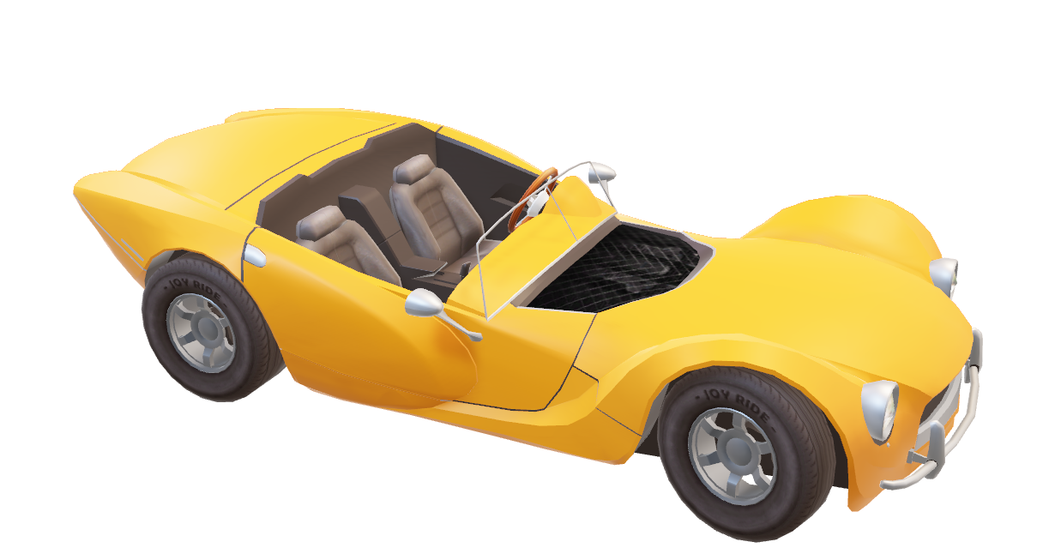
Autonomous: Self Driving Car
Group Members C13:
Arjun Sehgal -1811041
Ajay Bhan - 1811128
Project Mentor:
Prof. Zaheed Shaikh

Slide 2
PROBLEM DEFINITION
The automotive industry is experiencing a paradigm shift from conventional, human-driven vehicles into self-driving, artificial intelligence-powered vehicles. Self-driving vehicles offer a safe, efficient, and cost-effective solution that will dramatically redefine the future of human mobility.
Our project is squarely aimed at developing a simple IOT based self-driving car. With the use of Convolutional Neural Network and Image Processing we will build the model and identify appropriate navigation paths, obstacles and relevant signals.

Slide 3
SCOPE
Our system will include:
Lane detecting and following
Object recognition
Traffic Signs Detection
Stop Sign

Slide 4
OBJECTIVES:
Road Safety
Increased Productivity
Environment Friendly
Better traffic discipline
Reduced Expenditure

Slide 5
1. AN INTRODUCTION OF AUTONOMOUS VEHICLES AND A BRIEF SURVEY
Literature Survey:
This review paper addressed what the technologies and strategies are used in autonomous vehicles by literature reviews and the gap between them.
Survey report conducted in India :
The survey was conducted for public opinion about autonomous car technology and randomly chosen peoples in metropolitan, urban, suburban, and rural areas in India.
The study submits and filtered responses from 982 responses.

Slide 6
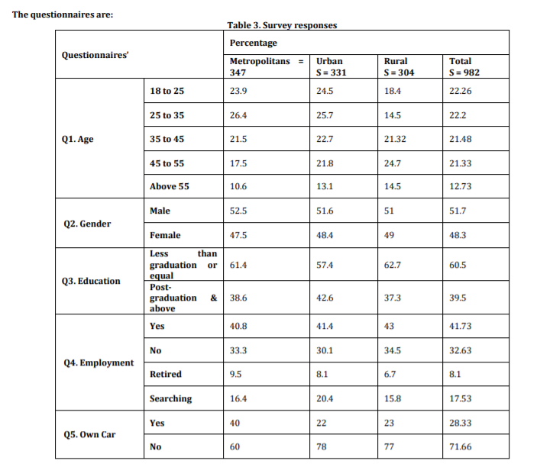

Slide 7
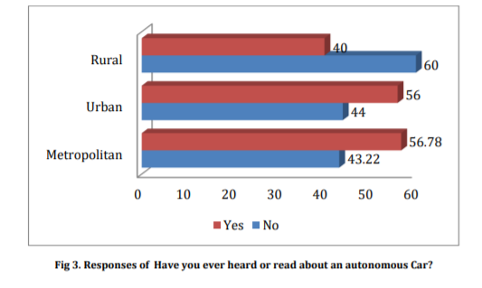
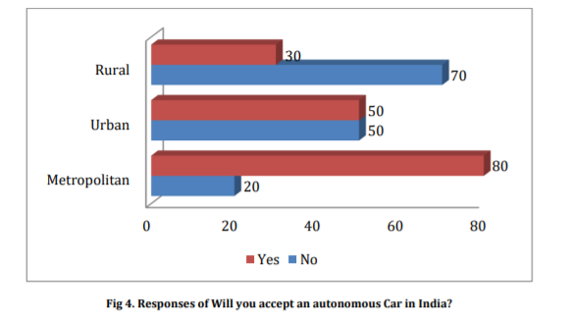
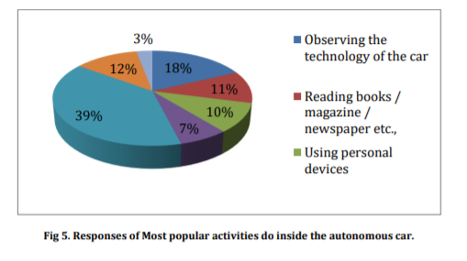

Slide 8
2. IoT based Self Driving Car
Literature Survey
This paper aims to represent a mini version of self-driving car using IOT with raspberry pi and Arduino UNO
The 8mp high resolution pi camera will provide the necessary information.
Raspberry pi will analyze the data(samples) and it will get trained with convolutional neural network .
With the use of Deep learning :
Detecting road lanes
Traffic lights and the car will take move accordingly.

Slide 9
200 samples of images were used.
High Resolution V2 Camera was used.
INFERENCE:
In various testing done by us it is found that despite of using high resolution V2 version of Raspbian camera lighting and different environmental conditions may affect the decision taken by the vehicle & to overcome this minor issue the training should be done precisely with perfect frame rates.

Slide 10
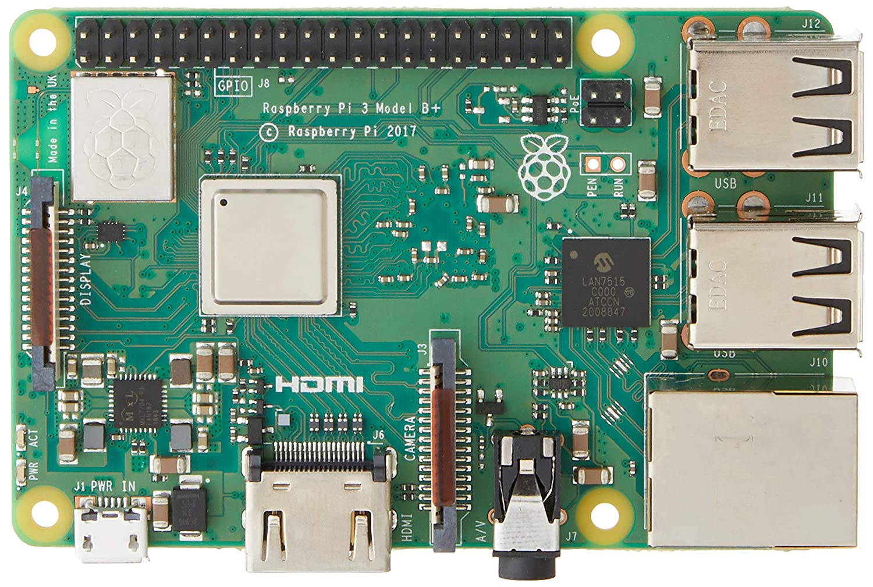
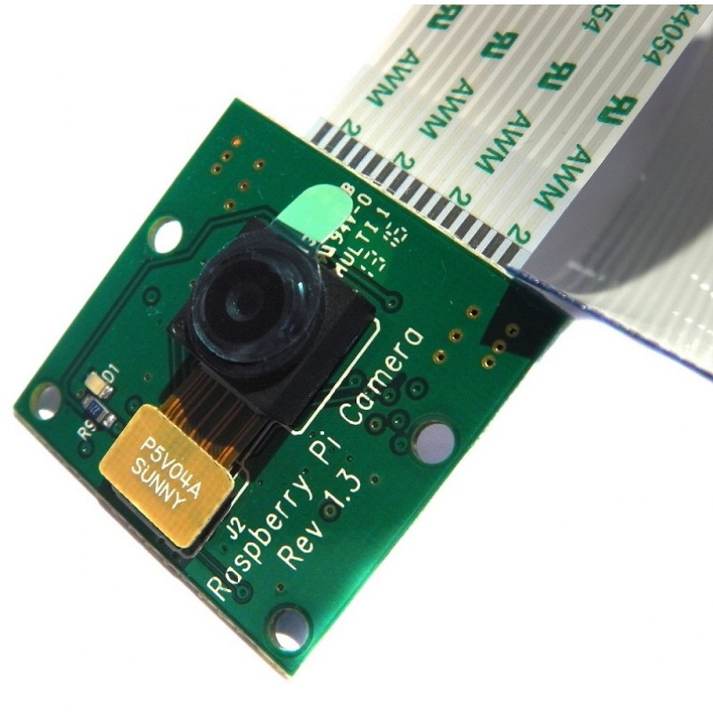
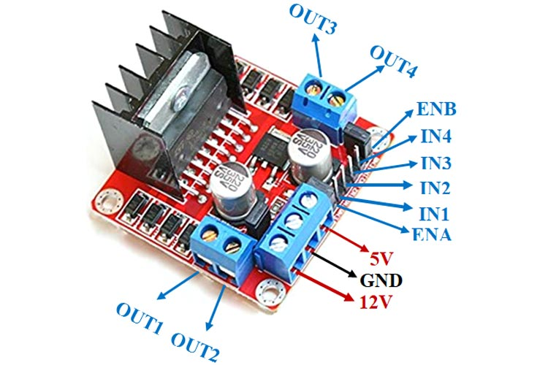
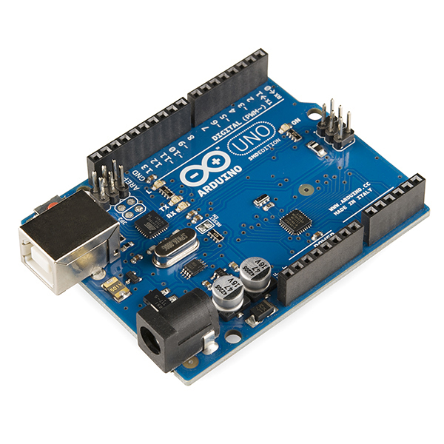
VARIOUS COMPONENTS
RASPBERRYPI 3B+ MODEL
RASPBERRY PI CAMERA
REV 1.3 VERSION 5 MP CAMERA
L298N MOTOR DRIVER
Arduino UNO

Slide 11
REQUIREMENTS:
Operating system - Windows 10 OS with C++ is needed.
Platform – Raspberry PI desktop Imager
Software Tools: -
Arduino 1.8.16
Advanced IP Scanner
Balena Etcher
PUTTY
Vnc Viewer
Hardware:
Raspberry PI 3B+
Arduino UNO
L298N Bridge
Raspberry PI Camera

Slide 12
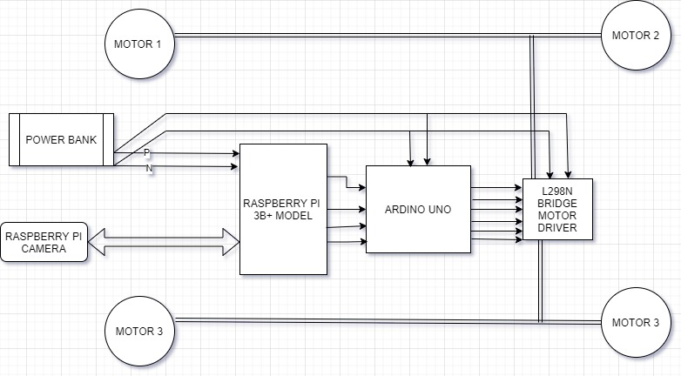
SYSTEM ARCHITECTURE:

Slide 13
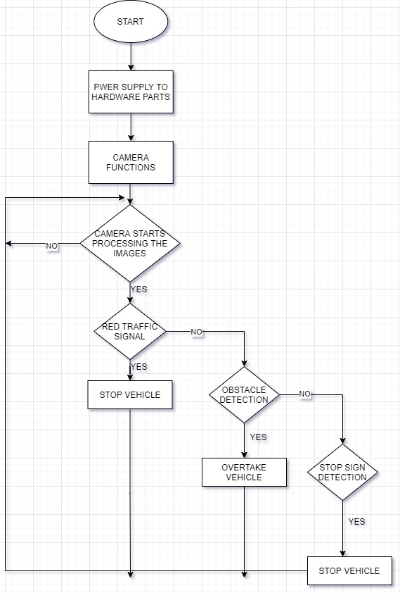
DESIGN OF PROPOSED SYSTEM:

Slide 14
Assumptions
The main assumption in this project is that the system works well when there are no environmental factors. (Bad weather, holes, slope, etc.)
Lane markings are assumed to be distinct.
For Obstacle Detection, we are considering no traffic and vehicle will overtake only from right.
In our system, it is assumed that all traffic signs and the presence of all objects around the vehicle can be clearly seen.
It is assumed that all system elements are operating properly and there are no abnormal conditions.

Slide 15
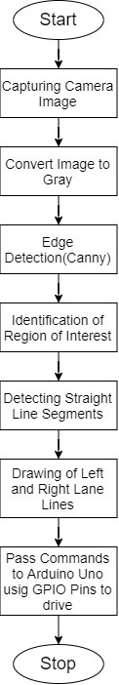
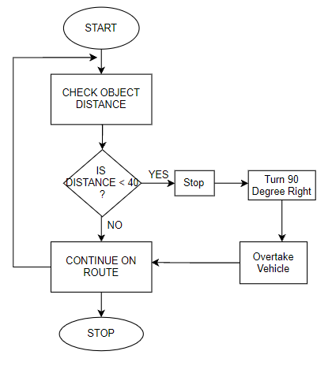
Lanes Detection
Obstacle Detection

Slide 16
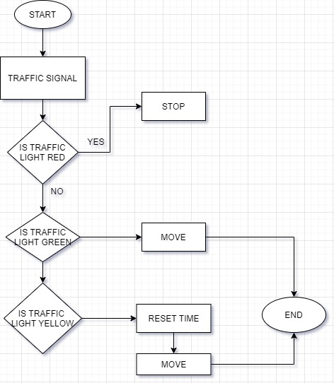
Traffic Signals Detection

Slide 17
Conclusion & Future Scope :
The model which we proposed is likely to have a significant impact on automated driving technology, either by overcoming the weakness of previous methods or by proposing an alternative.
Future Goals:
Control Speed of Motors
Traffic Detection
Parking Car System
Night Light Cameras
Using Multiple Cameras

Slide 18
Challenges
Incorrect and Improper connections will lead to failure of circuits.
Low Quality Camera might be challenging while capturing the images at night.
Lack of knowledge in handling IOT devices.
Heating Problems might be an another important challenge when system used for longer time.

Slide 19
Objectives that will be achieved by the end of 7th Semester.
Complete literature survey
Complete Software and Hardware Requirements
Designing of model
Working Prototype Model

Slide 20
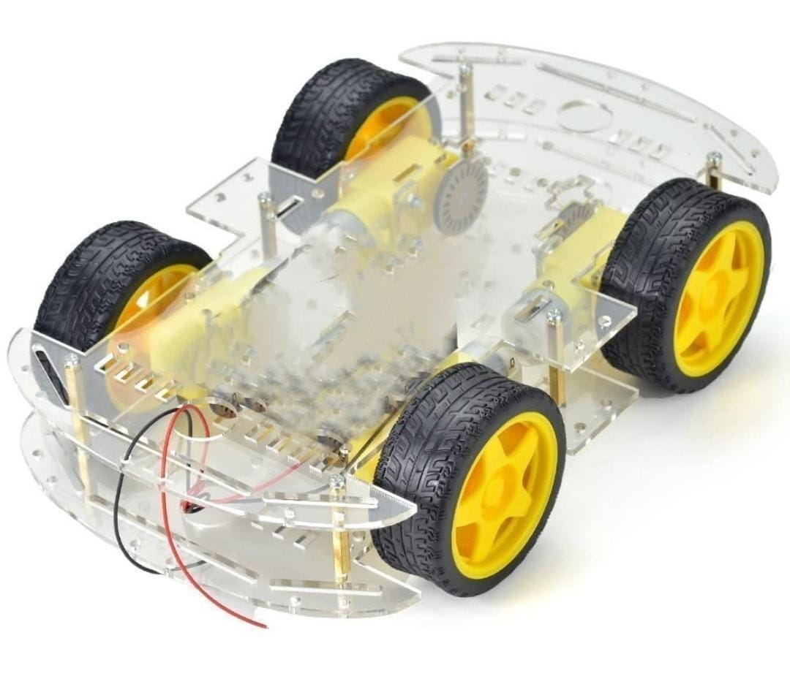
Specification of Product:
Equivalent Weight: 600g
Production Dimensions (LXBXH) : 14 X 5 X 5 cm

Slide 21
REFERENCES:
[1] Aditya Kumar Jain, “Working model of Self-driving car using Convolutional Neural Network, Raspberry Pi and Arduino”, Proceeding of the 2nd International Conference on Electronics, Communication and Aerospace Technology (ICECA), IEEE, 2018, pp: 1630- 1635.
[2] Raivo Sell, Anton Rassõlkin, Mairo Leier, Juhan-Peep Ernits, “Self-driving car ISEAUTO for research and education”in 19th international conference onResearch and Education in Mechatronics (REM), IEEE, 2018, pp: 111-116.
[3] T. Banerjee, S. Bose, A. Chakraborty, T. Samadder, Bhaskar Kumar, T.K. Rana, “Self Driving Cars: A Peep into the Future”, IEEE, 2017, pp: 33-38.
[4] Qudsia Memon, Muzamil Ahmed and ShahzebAli, “SelfDriving and Driver Relaxing Vehicle”, in IEEE 2016, pp: 170-174.
[5] Mohammad Faisal Bin Ahmed, Md. Saef Ullah Miah, Md. Muneef Anjum Timu, Shakura Akter, Md. Sarker.b, “The Issues and the Possible Solutions for Implementing SelfDriving Cars in Bangladesh” in Regin 10 Humanitarian Technology Conference(R10-HTC), IEEE,2017, pp: 250- 254.
[6] Margrit Betke, EsinHaritaoglu, Larry S.Davis,“Real-time multiple vehicle detection and tracking from a moving vehicle”, in Machine Vision and Application, IEEE, 2000, pp: 69-83

Slide 22
[7] Chun-Che Wang, Shih-Shinh Huang and Li-Chen Fu, PeiYung Hsiao “Driver Assistance System for Lane Detection and Vehicle Recognition with Night Vision”, IEEE
[8] Ruturaj Kulkarni, Shruti Dhavalikar, Sonal Bangar, “Traffic Light Detection and Recognition for Self Driving Cars using Deep Learning” in 4th International Conference on Computing Communication Control and Automation(ICCUBEA), IEEE, 2018.
[9] R. Mohanapriya, L.K. Hema, Dipesh warkumar Yadav, Vivek Kumar Verma, “Driverless Intelligent Vehicle for Future Public Transport Based On GPS”, in International Conference on Signal Processing, Embedded System and Communication Technologies and their applications for Sustainable and Renewable Energy (ICSECSRE `14),Vol. 3 Special Issue 3, April 2014, pp: 378-

